Slide 1
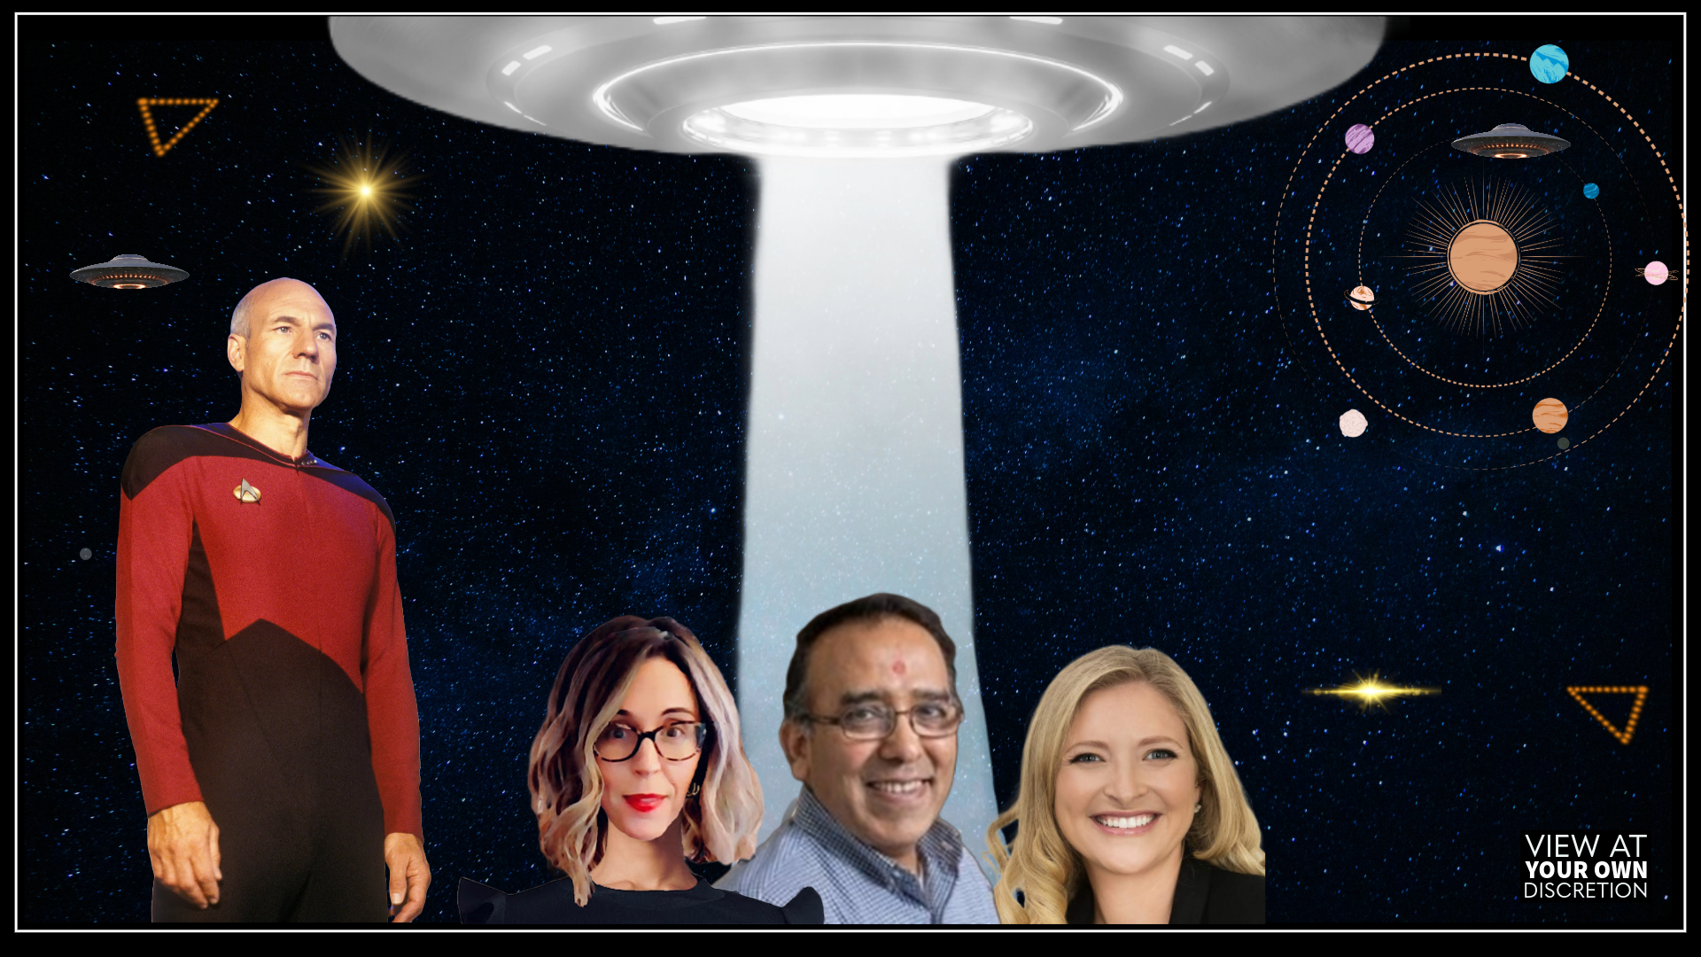
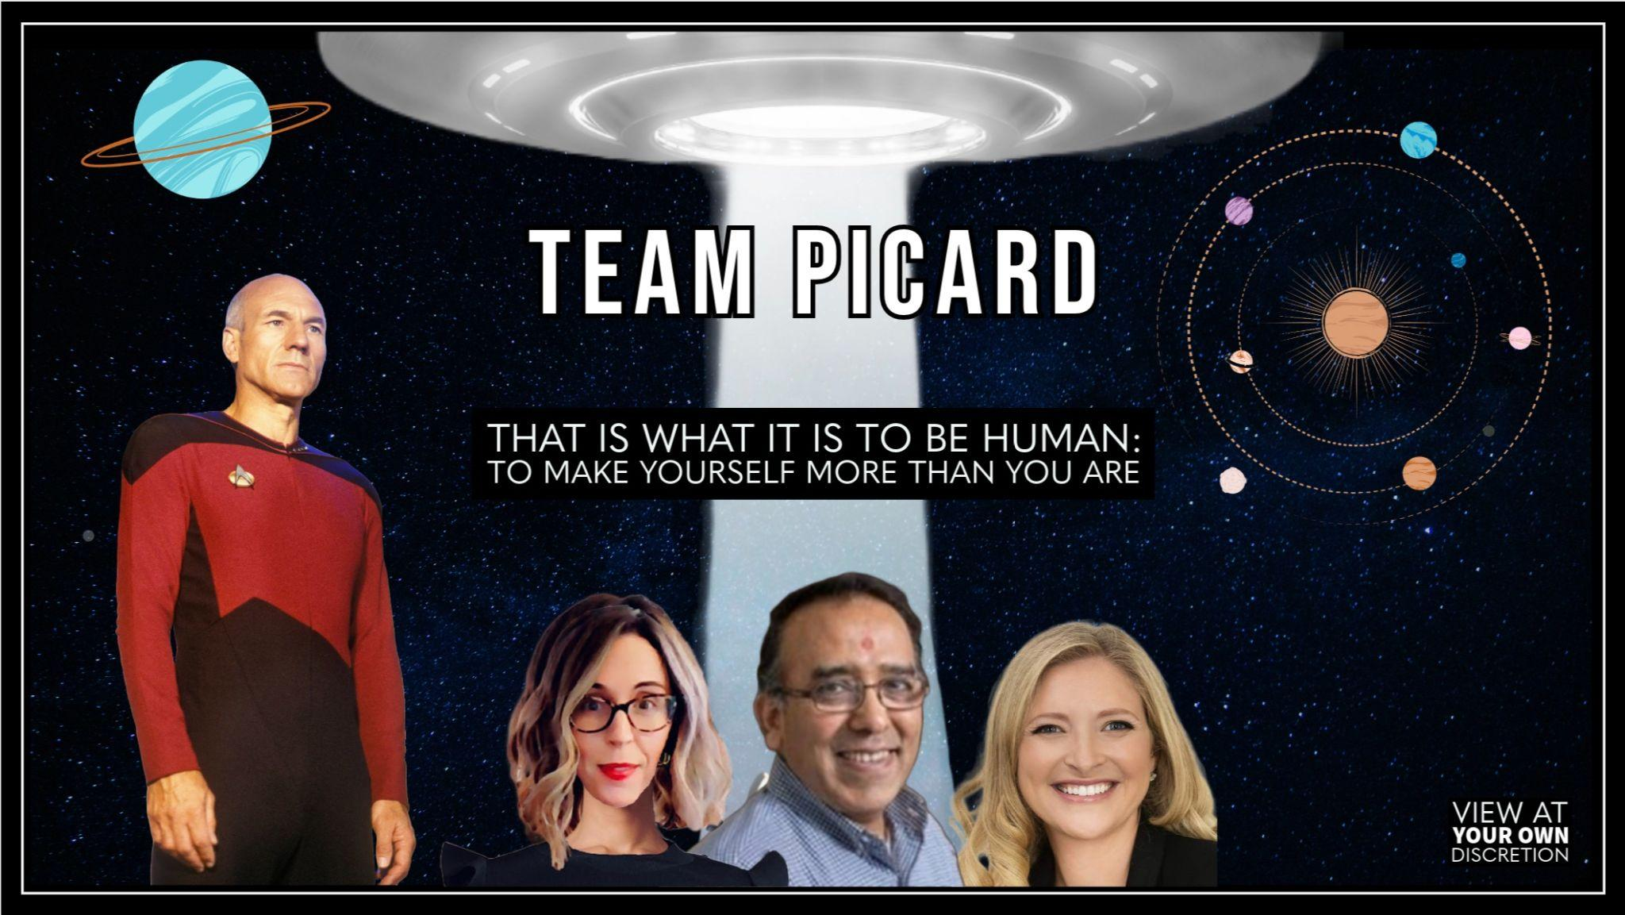
TEAM PICARD

Slide 2
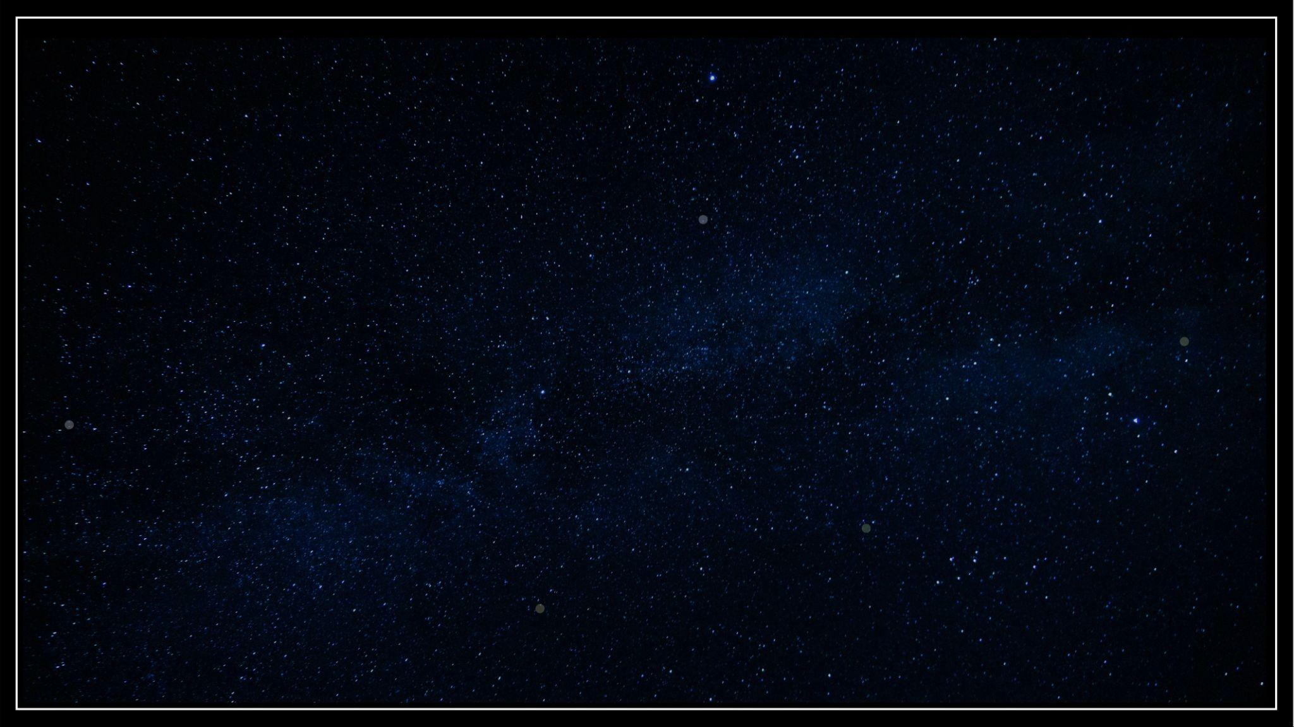
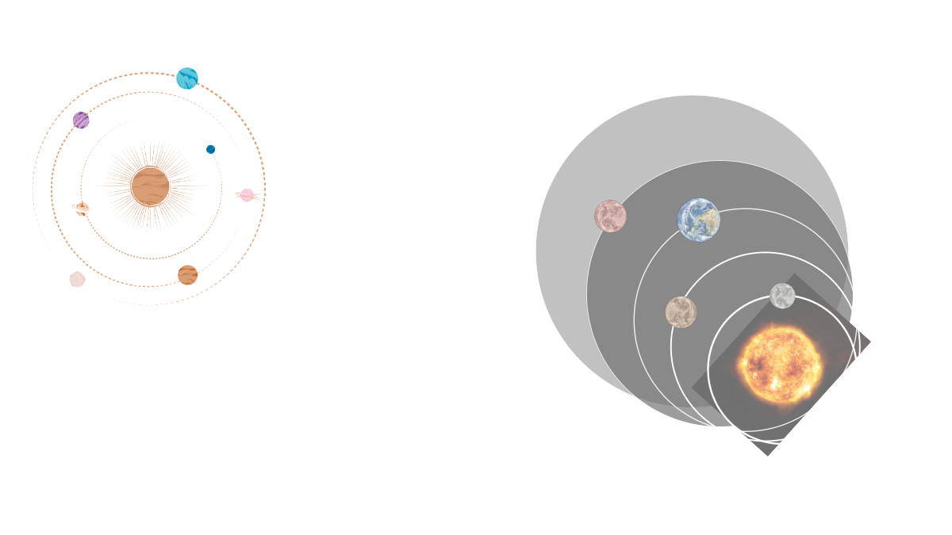
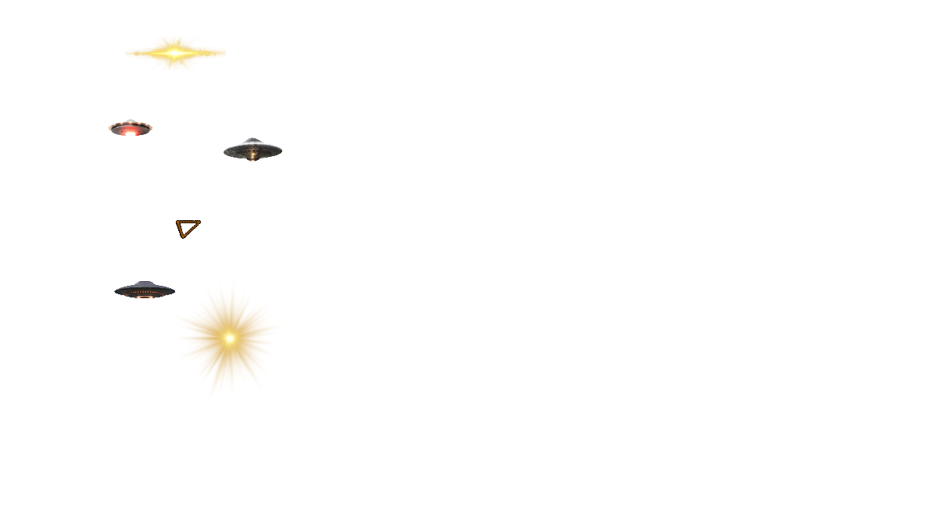
SOMETHING IS HAPPENING IN OUR SKIES
For decades there have been strange, unexplained sightings in the sky by the military, commercial airline pilots, and other trained observers all over the world
Many of these sightings have been confirmed by radar and FLIR (Forward Looking InfraRed) radar data
UFOs have been acknowledged by the U.S. Government in a recent report as a genuine mystery they have been studying for years
This topic should be taken seriously, without stigma, by our scientific communities and the general public so we can study and have a better understanding of the universe around us
Notes:
draft

Slide 3

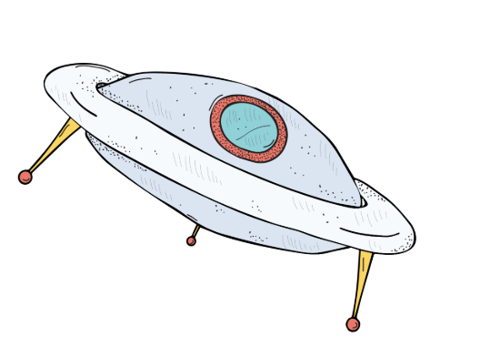
CREDIBLE GOVERNMENT OFFICIALS SPEAKING OUT
Harry Reid
Senate Majority Leader, NV
Paul Hellyer, Canada's
former minister of Defence
David Grush
Former intelligence official
Has been sounding the alarm on the need to find out what UFOs are since 2007.
Testified in D.C. in 2014 that “aliens are living among us” and “working with the U.S. government,” among other bombshells.
Testified the “U.S. government has evidence of "non-human" biologics.”
Haim Eshed, former Israeli Defense General & Space Chief
Nick Pope, Former officer,
British Ministry of Defence
Luis Elizondo, former intelligence officer, US DoD
2020: Claimed there’s a “galactic federation,” and that aliens are on a mission to understand the “fabric of the universe.”
Resigned as head of the Pentagon’s UFO Program because “UFOs exist — but the government doesn’t want you to know it.”
Where his duties included investigating reports of UFO sightings. Sounding the alarm since he left in 2006.
Notes:
https://www.huffpost.com/archive/ca/entry/paul-hellyer-ex-defence-minister-believes-in-aliens-video_n_3390295

Slide 4
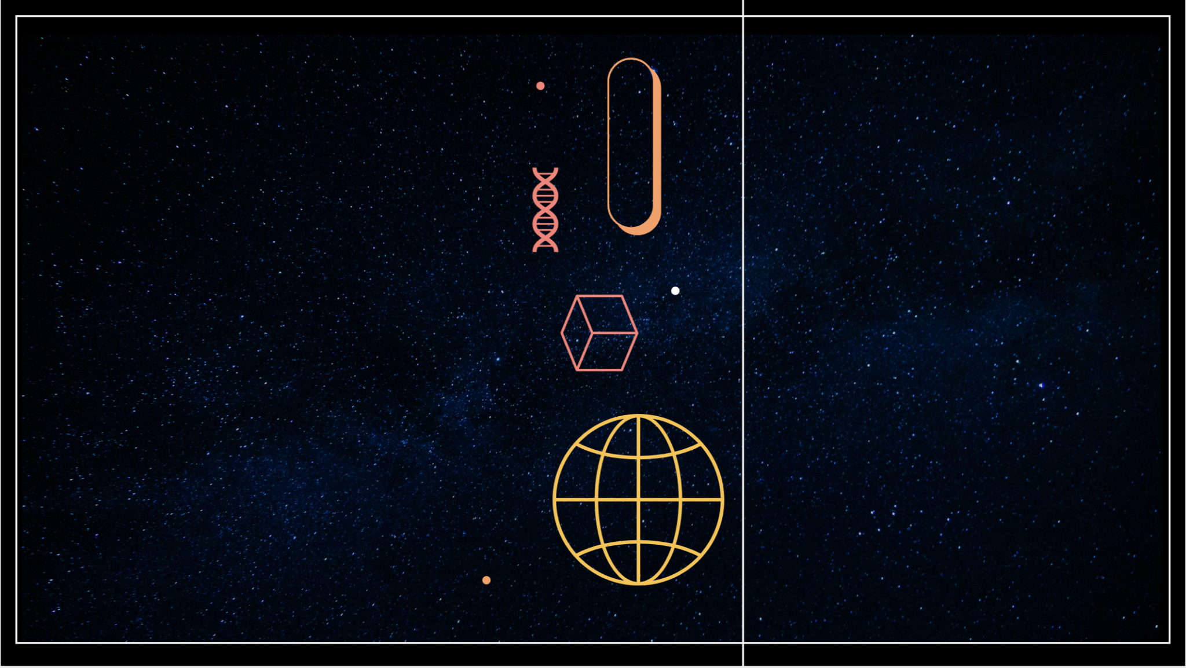
EXECUTIVE SUMMARY
QUESTIONS
What can we learn about previously documented and recorded UFO sightings?
What is the trend?
How do we utilize the trend to predict future sightings?
Are We Alone?
As far back as 1459 B.C., humans have documented unknown, technological objects in the sky
Congressional, Pentagon and various intelligence agencies reports concluded some are real, unknown objects
Sharing information on the basis of open data to answer a question that is clearly of great interest to the public, will enhance confidence in evidence-based knowledge
Provides the potential to learn so much, from technological advances to the meaning behind existence
NASA’s 2023 UAP Report noted that artificial intelligence and machine learning are essential for identifying rare occurrences, including UFOs
APPROACH
Divided and conquered based on everyone’s strengths
Understood the raw data
Identified key targets and sliced data as necessary
Stayed open-minded and willing to go where no (hu)man has gone before
Notes:
How did we pick UFOs?
An executive summary or overview of the project and project goals:
Explain how the project relates to the industry you selected.
Questions?
What can we learn about previously documented and recording sightings UFO sightings?
Can we use this historical data to predict trends in future UFO sightings?
Can we use historical data to predict future UFO sightings?
Our approach

Slide 5
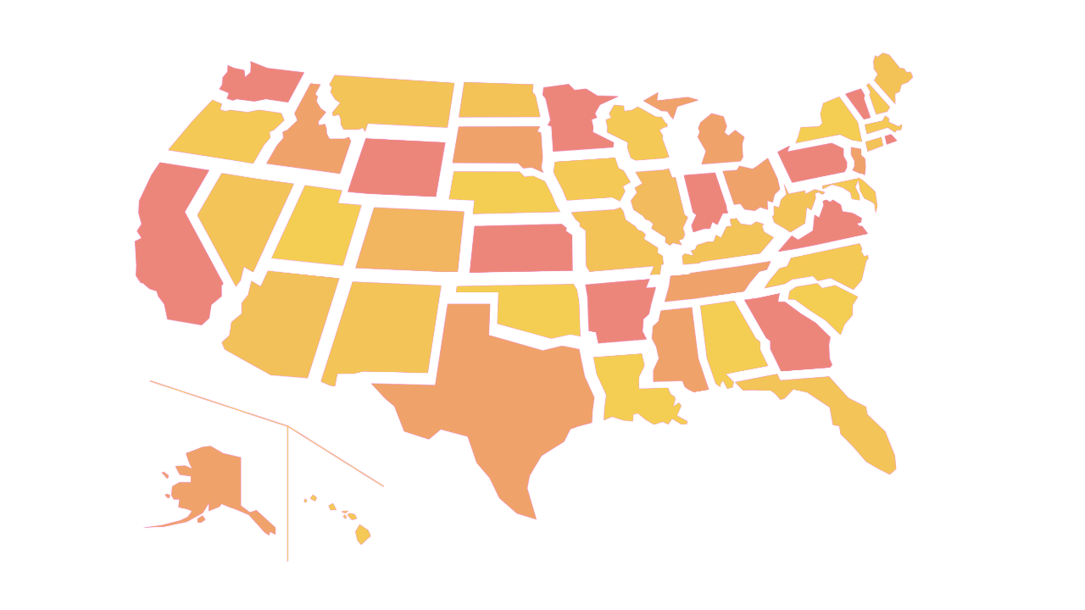
1997 Phoenix, AZ Lights
Hundreds of witnesses claimed to see "otherworldly" lights across AZ, NV and Mexico
CREDIBLE UFO SIGHTINGS
2001 New Jersey Turnpike
Drivers marveled at the sight of strange orange and yellow lights in a V formation over NY and NJ
2004 San Diego, CA USS Nimitz
Carrier strike group tracked objects at 80,000 ft high plummet to hover right above the Pacific
2006 Chicago, IL O'Hare Airport
UFO sighting witnessed by 12 United Airlines employees outside and above the airport
2008 Stephenville, TX Sightings
Reported white lights in a single horizontal arc, then in vertical parallel lines a mile long traveling 3,000 mph
2010 Washington, DC
Missile launch officers saw UFOs hovered over launch sites send beams of light into silos holding nuclear missiles, sometimes disabled or briefly activated them
2011 Lafayette, CO Sightings
Residents saw a strange triangular formation of lights hovering above Lafayette that looked like tiny, bright alien ships. No sound was reported

Slide 6

DATA

Slide 7
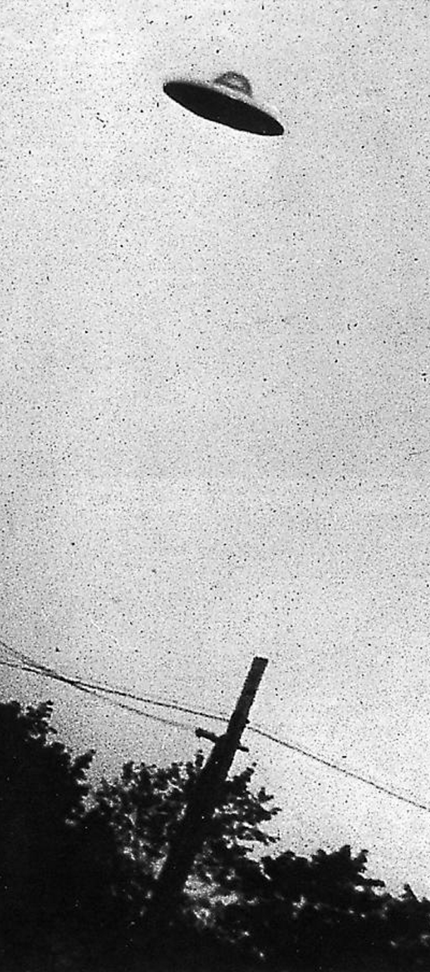
DATA COLLECTION, CLEANUP, AND EXPLORATION PROCESSES
The Proof is Out There
Began with a massive CSV file with global data from 1910 - 2014, retrieved from NURORC, which was used in week of 5 class
To reach our end goals, we needed to create a more manageable dataset and so we divided our clean-up and exploration into phases:
Phase 1: Cleaning and filtering the dataset to improve its usability and narrow the scope of our project
Phase 2: Identifying the most active period and states for UFO sightings
Phase 3: Predictions of State Data
Phase 4: Exploration and analysis of shapes of sightings
Phase 5: Predictions and Geo-Visualizations

Slide 8
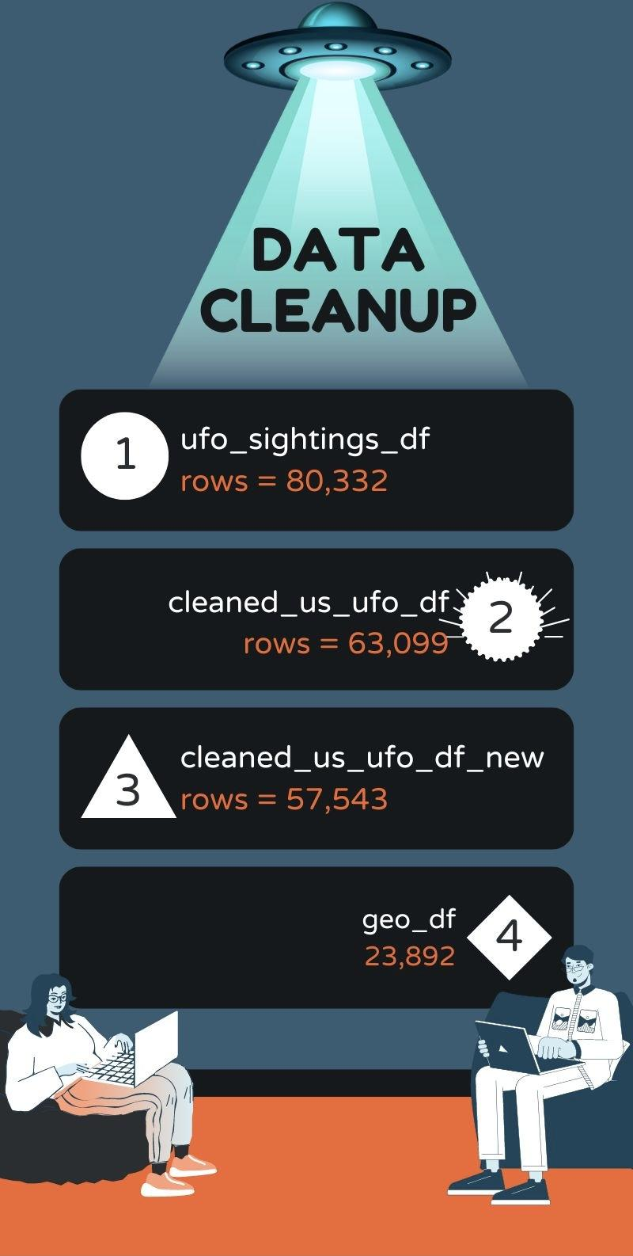
RESULTS

Slide 9
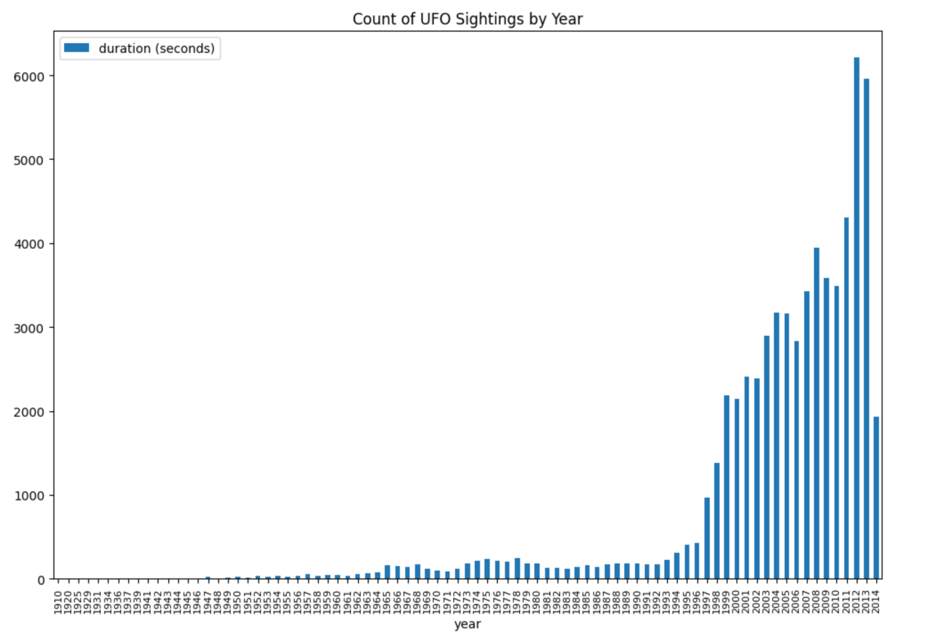
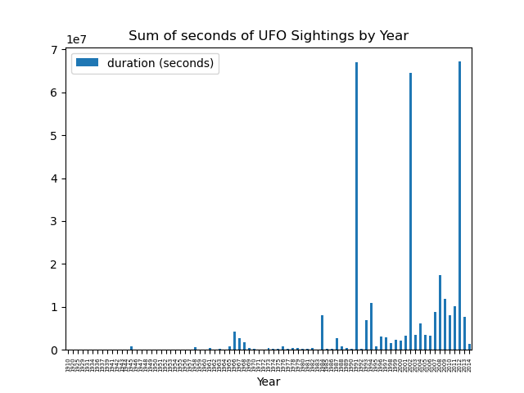
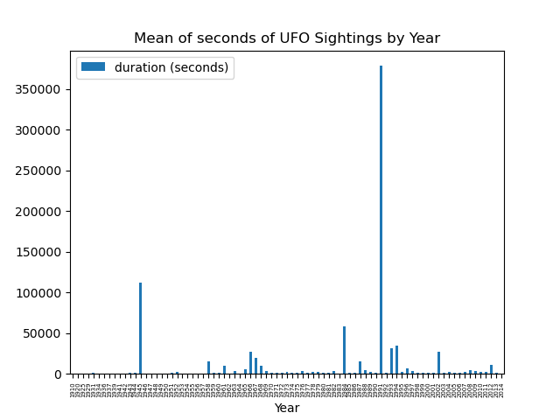
WHAT DOES DATA SHOW
Count
Sightings in seconds, by year
Mean
Sum

Slide 10

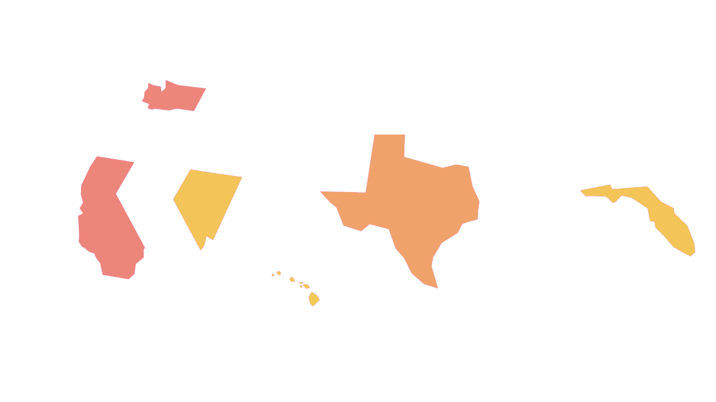
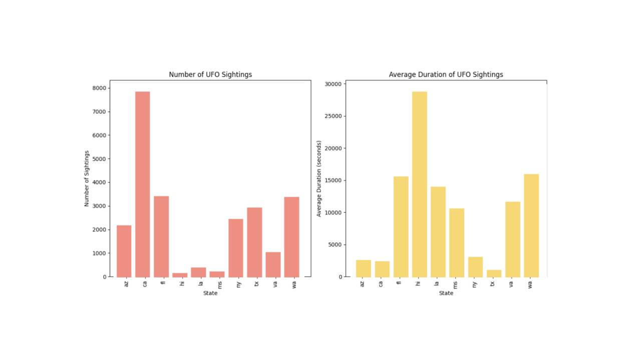
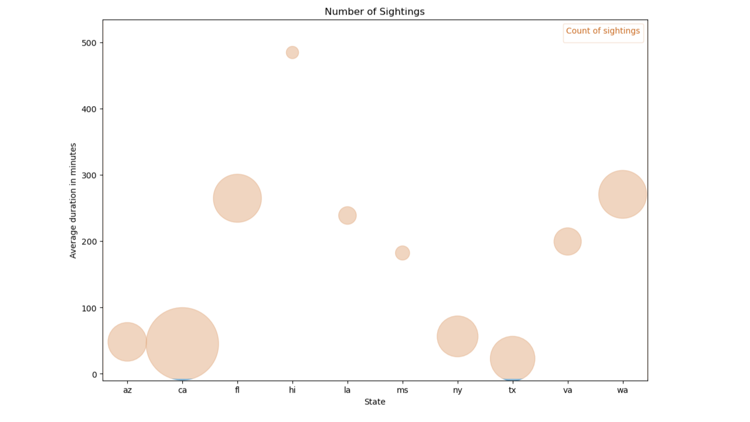
REFINING THE GEOGRAPHIC SCOPE OF DATA
Count and Duration
Top 10 states
Arizona, California, Hawaii, Louisiana, Mississippi, New York, Texas, Virginia, and Washington
Two ways to represent data

Slide 11
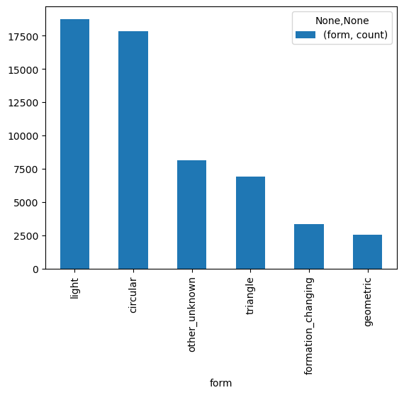
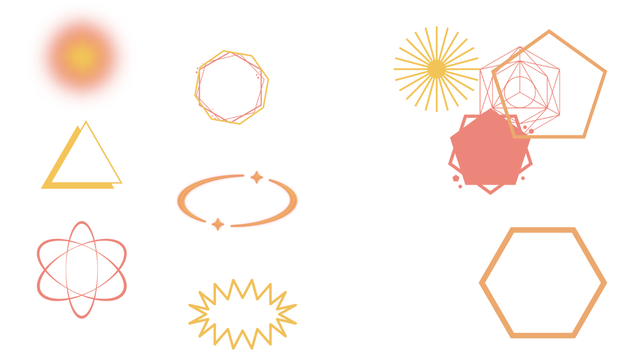
The Shapes of Things to Come
Comparing states and national trends
Unwieldy database with 28 number of options
Grouped shapes into 6 subsets
Majority: Light and Circular
Would we observe any trends in shape of the reported sightings by year, state, and sighting (count vs. long duration)
Triangle
Other /
Unknown
Formation / Changing
14%
12%
6%
Light
Circular
Geometric
32%
31%
4%

Slide 12
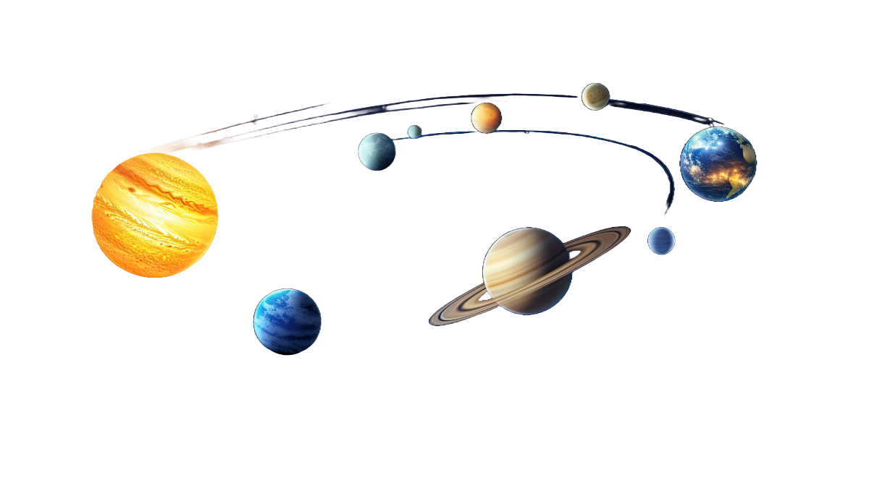
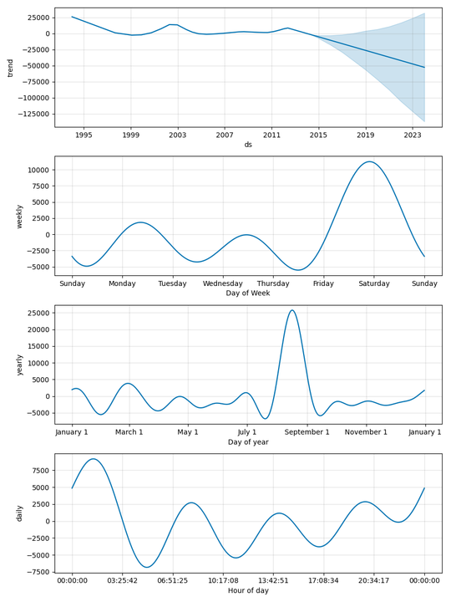
PREDICTING THE UNPREDICTABLE
Next Steps
The data seem to show a slight downward trend
Best day to view seems to be Saturday
Best time of the year - Mid to late August
Mid night through 3am is the best time
This data can be used for states to market to UFO enthusiasts. Here is a suggested tagline
Beyond the Stars: Visualizing UFO Encounters

Slide 13

REFLECTIONS AND OPPORTUNITIES
Reflections
Dataframe ends in mid-2014 and though we found a pretty reputable options to add data until 2020, we just ran out of time
Pretty large dataframe and though it was well vetted, it was difficult to work with before cleaning and took the bulk of our time
Dataset is well designed but is based on self-reporting to inherent issues
Longitude
Briefly discuss potential next steps for the project.
Confirm accuracy of the dataframe that if available to expands data to 2020
Clean and merge
Compare expected forecast with actual results and forecast out from 2020
Further explore the data and relationships
Opportunities

Slide 14
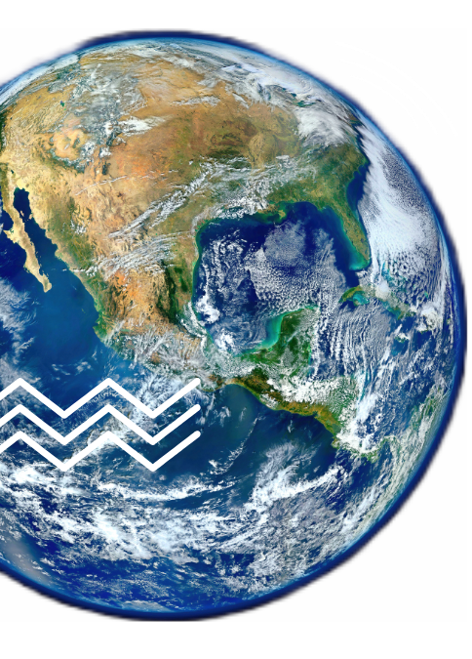
👀
Cosmic Encounters: Explore UFO Sightings Interactively
Interactive and easy find formations by state
Hover over shows data from key fields of specific encounter
Filtering the data graphically
Zoom in to a specific area for more information

Slide 15



“One man cannot summon the future.”
-Spock
Credits, references and thank yous - we couldn't have done it alone
Resources Consulted and Credit
abbreviation_to_name credit: Jeff Pain
https://gist.github.com/JeffPaine/3083347
The curriculum team and Bootcamp Spot for providing us access to the original ufoSightings.csv dataset, which we explored in Module 5
Zohaib Khawaja, for helping us find a solution to convert longitude to a numeric so that we could build our geo-visualization.

Slide 16
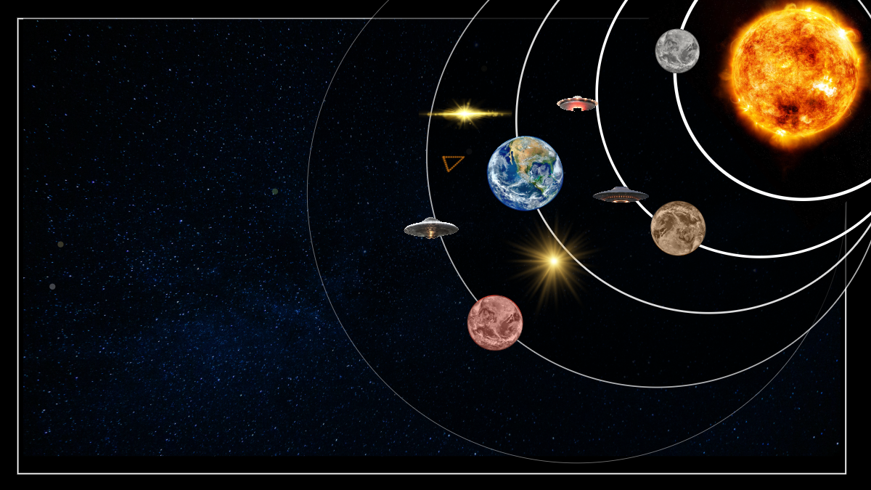

QUESTIONS?
Ask at your own risk

Slide 17


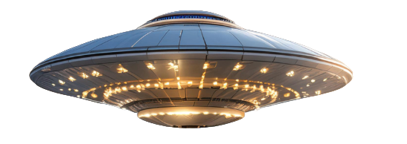
THANK YOU!
See you in the orbit

